Slide 1

SEMINAR ON
AN INTELLIGENT AMBULANCE AND TRAFFIC CONTROL SYSTEM
GOVERNMENT POLYTECHNIC GONDIA
PRESENTED BY:-
SIDDHARTH G. GUPTA
DEVESH A. KHANZODE

Slide 2
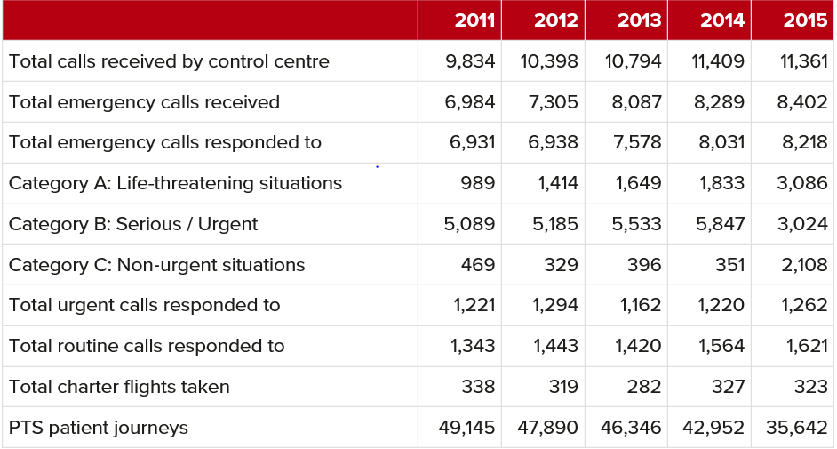
STATISTIC OF THE AMBULANCE CALLED UP BY THE PATIENT

Slide 3
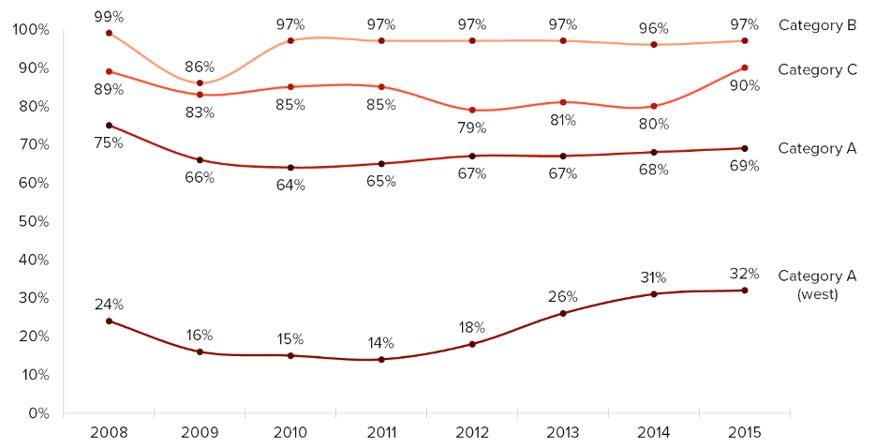
PERCENTAGE OF AMBULANCE CALLED UP BY THE PATIENT IN 2008 TO 2015
https://www.gov.je/Government/JerseyInFigures/EmergencyServices/Pages/AmbulanceService.aspx

Slide 4
TABLE OF CONTENTS
INTRODUCTION
WORKING PRINCIPLE
PROPOSED SYSTEM
HARDWARE MODULE
5. SYSTEM UNITS
6. ADVANTAGES
7. DISADVANTAGES
8. FUTURE SCOPE
9. CONCLUSION
REFERENCES

Slide 5
1. INTRODUCTION
This particular paper is designed for the cities with heavy traffic.
The road accidents in modern urban areas are increased to uncertain level.
ITLS (Intelligent Traffic Light system).
The main theme behind this scheme is to provide a smooth flow for the emergency vehicles like ambulance to reach the hospitals in time and thus minimizing the delay caused by traffic congestion.

Slide 6
2. WORKING PRINCIPLE
AMBULANCE UNIT
Contains GSM, GPS MODULE and RFID tag with microcontroller 8051 (AT89S52)
SERVER OR PC AT HOSPITALS
AMBULANCE DETECTOR (Street Light)
Contains RFID module for ambulance detection with microcontroller 8051 (AT89S52)
TRAFFIC CONTROL SYSTEM
Contains microcontroller 8051 (AT89S52) and traffic lights which are to be controlled

Slide 7
3. PROPOSED SYSTEM

Slide 8
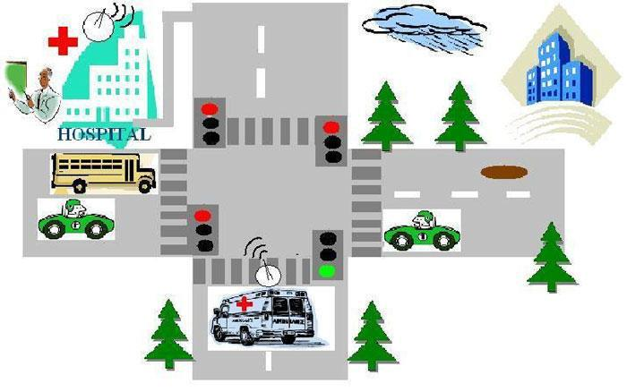

AMBULANCE

Slide 9
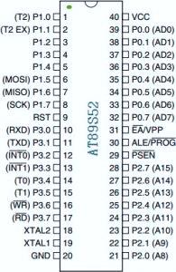
4. HARDWARE MODULES
  4.1. Microcontroller (89S52)

Slide 10
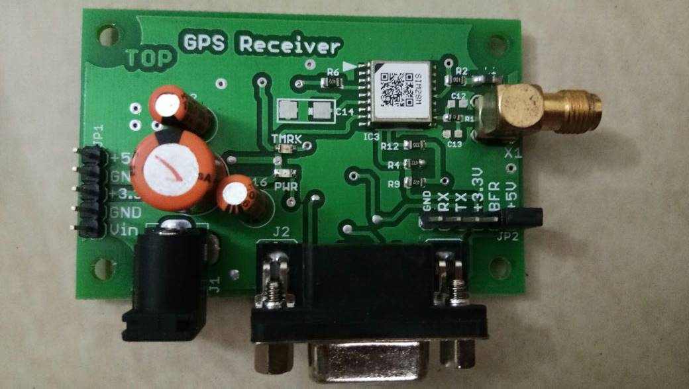
4.2. GPS (GLOBAL POSITIONING SYSTEM) MODULE

Slide 11
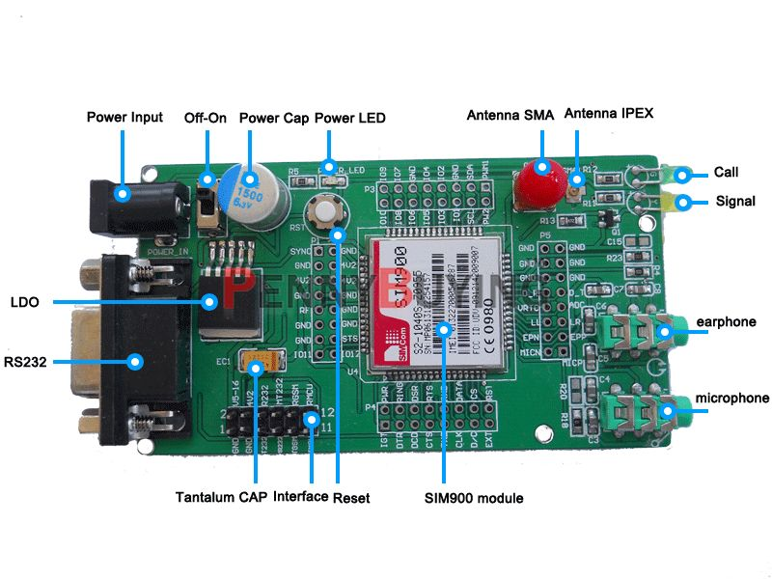
4.3. GSM (GLOBAL SYSTEM FOR MOBILE COMMUNICATION) MODULE

Slide 12
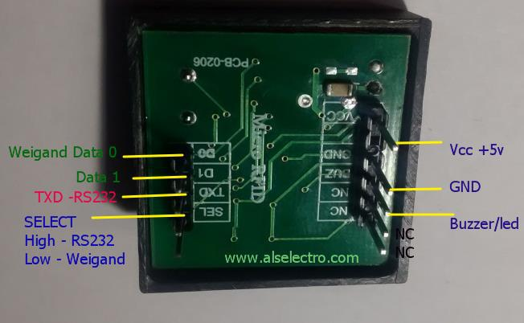
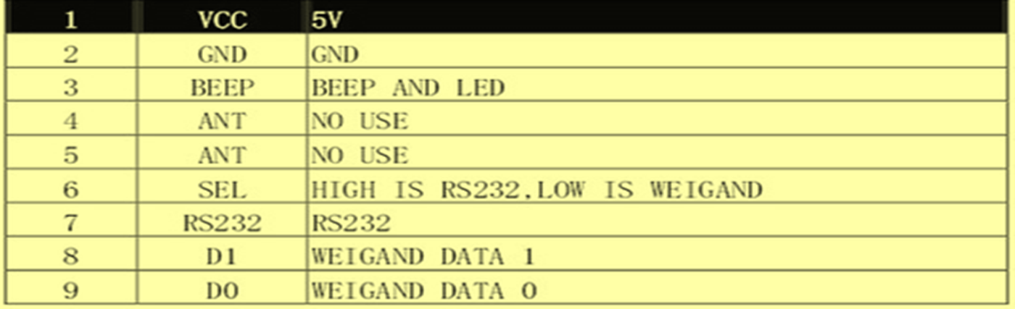
4.4. RFID (RADIO FREQUENCY IDENTIFICATION) READER

Slide 13
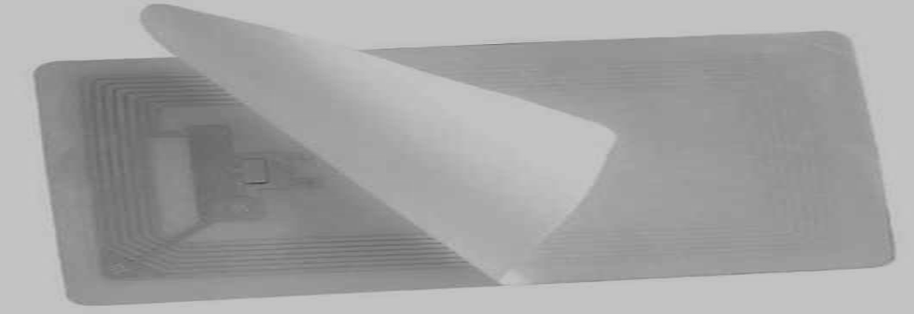
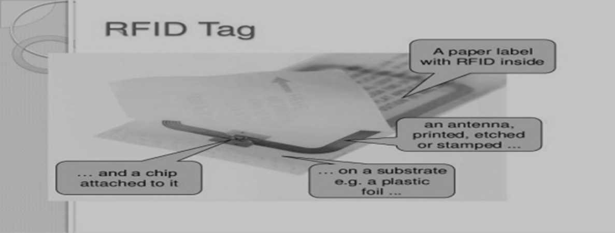
4.5. RFID (RADIO FREQUENCY IDENTIFICATION) TAG

Slide 14
5. SYSTEM UNITS
5.1. AMBULANCE UNIT
89S52
GPS MODULE
POWER SUPPLY
GSM MODULE
SENSORS

Slide 15
5.2. TRAFFIC UNIT
89S52
RFID MODULE
POWER SUPPLY
TRAFFIC SIGNAL

Slide 16
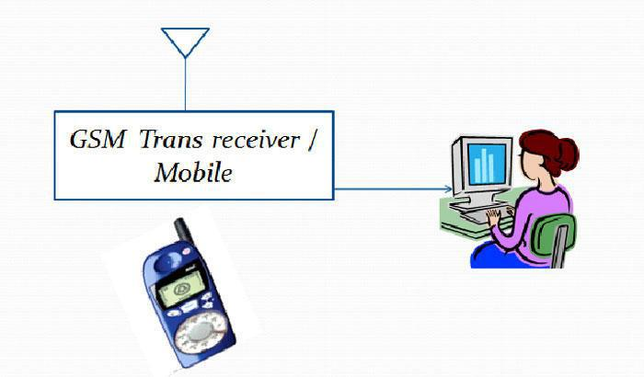
5.3. HOSPITAL UNIT

Slide 17
6. ADVANTAGES
Improves traffic flow for emergency vehicle.
Possible to serve patient according to doctor’s suggestions in ambulance.
Saves patient’s life in critical cases.
Preparation can be done before reaching the ambulance at the hospital.

Slide 18
7. DISADVANTAGES
If ambulance gets stolen then thief can be eliminated easily.

Slide 19
8. FUTURE SCOPE
4G module can be used for more fast network.
By using higher level GPS module, accuracy can increased.
Operation theater can be inbuilt inside the ambulance.
By using world wide network ambulance can be passed from any traffic post.
Ambulance can be encrypted by hospital for safety.

Slide 20
9. CONCLUSION
The following paper will help to assuage blockage of emergency vehicles in traffic by the usage of electronics and communication technique.
The most common use of these systems is to manipulate traffic signals in the path of an emergency vehicle, stopping conflicting traffic and allowing the emergency vehicle right-of-way, to help reduce response times and enhance traffic safety.
The overall paper along with the process of traffic light control also shows the message and visual communication using GSM with 3G connection in Ambulance.

Slide 21
REFERENCES
[1]MAZIDI &MAZIDI, “8051 Microcontroller and embedded systems (2nd Edition)”, Prentice Hall Publications, 2009.
[2] Claudio De Capua, Antonella Meduri, and Rosario Morello. "A Smart ECG Measurement System Based on Web-Service Oriented Architecture for Telemedicine Applications" IEEE TRANSACTIONS ON INSTRUMENTATION AND MEASUREMENT, VOL. 59, NO. 10, OCTOBER 2010.
[3] Bor-Shyh Lin, Willy Chou, Hsing-Yu Wang, Yan-Jun Huang and jeng-Shyang Pan, "Development of Novel Non-Contact Electrodes for Mobile Electrocardiogram Monitoring System", IEEE journal of Translational Engineering in Health and Medicine, Digital Object Identifier 10.1109/JTEHM.2013.2253598.
[4] Rajeshwari Sundar, Santhoshs Hebbar, and Varaprasad Golla "Implementing Intelligent Traffic Control System for Congestion Control, Ambulance Clearance, and Stolen Vehicle Detection", IEEE sensor journal, VOL. 15, NO. 2, FEBRUARY 2015.

Slide 22
THANK YOU

Slide 23
ANY QUERIES ?

